Slide 1
Classification Keys
Year 7 Science

Slide 2
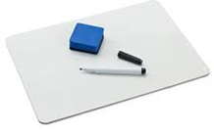
Review
K
P
C
O
F
G
S
What type of features are used to classify animals?
What is the scientific name for humans?

Slide 3
Learning Intentions
Grouping a variety of organisms on the basis of similarities and differences in particular features

Slide 4
Success criteria
Use a classification key (dichotomous key) to classify objects or organisms
Identify features which may be used to classify animals

Slide 5
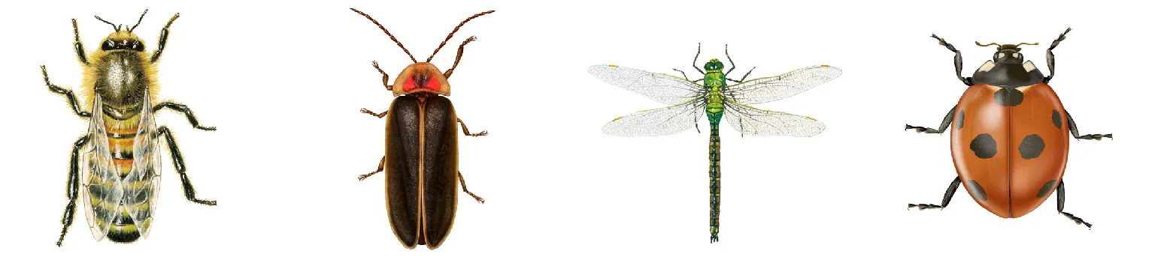
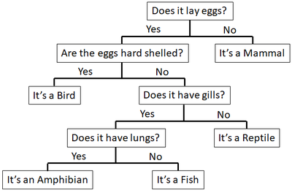
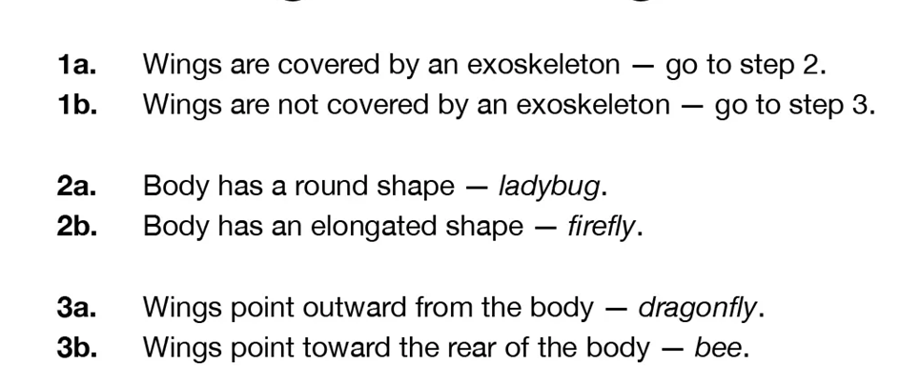
Two types of classification keys

Slide 6
Activity 1: Make a dichotomous key

Slide 7
Activity 2: Use a dichotomous key

Slide 8
Success criteria
Use a classification key (dichotomous key) to classify objects or organisms
Identify features which may be used to classify animals

